Slide 1

Employee Attrition Analysis
Name : Yahavarshini
Date : 08-04-2025

Slide 2
Project Overview
This project analyzes employee attrition to understand why employees leave the company.
Tools Used : Power BI
Goals
Identify Key Attrition Factors
Measure Attrition & Retention Rates
Improve Employee Retention

Slide 3
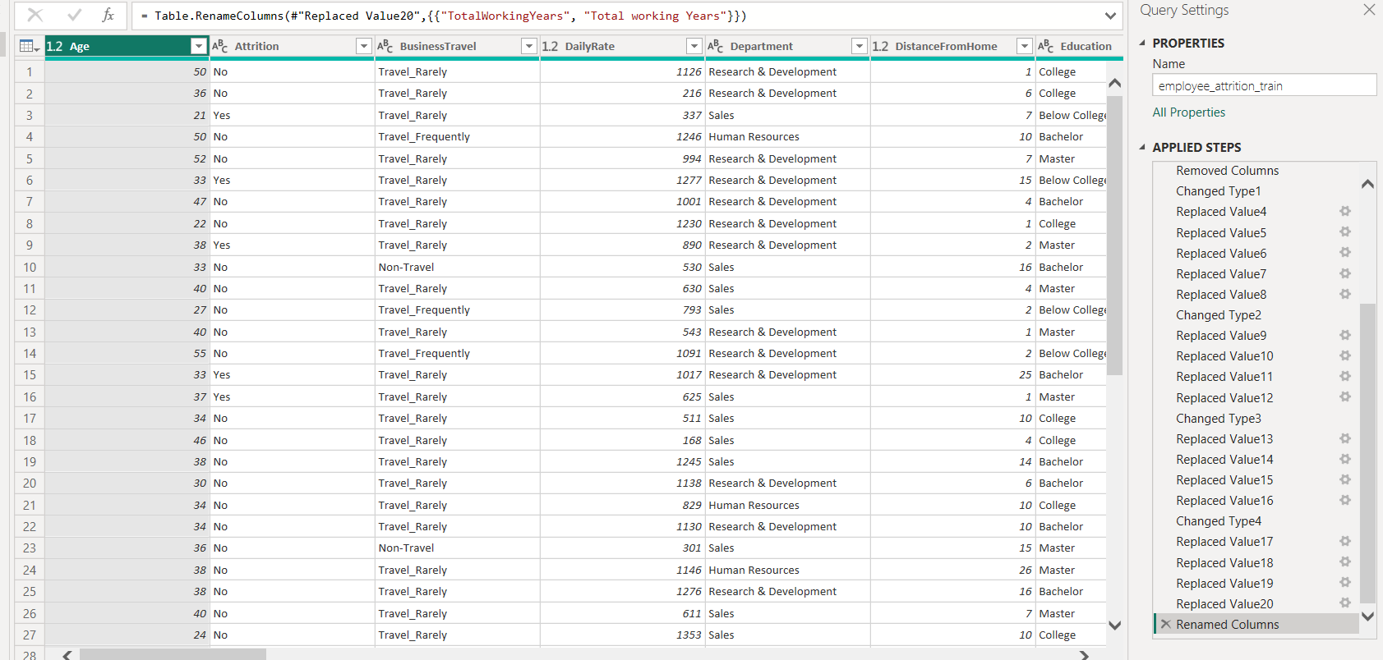
Dataset Overview
Dataset Cleaning
Rows & Columns : 1000+ & 30+
Attributes of the dataset (Age, Daily rate, Job role, Monthly Income, Job satisfaction, etc.)
Handled Missing Values
Standardized Data

Slide 4
Dax Functions
Enhances data interpretation by grouping Age into Age range
Improves decision-making by calculating attrition and retention rate
Categorizes employees into Low, Medium, and High salary bands using switch
Provides dynamic filtering capabilities to explore data across various dimensions

Slide 5
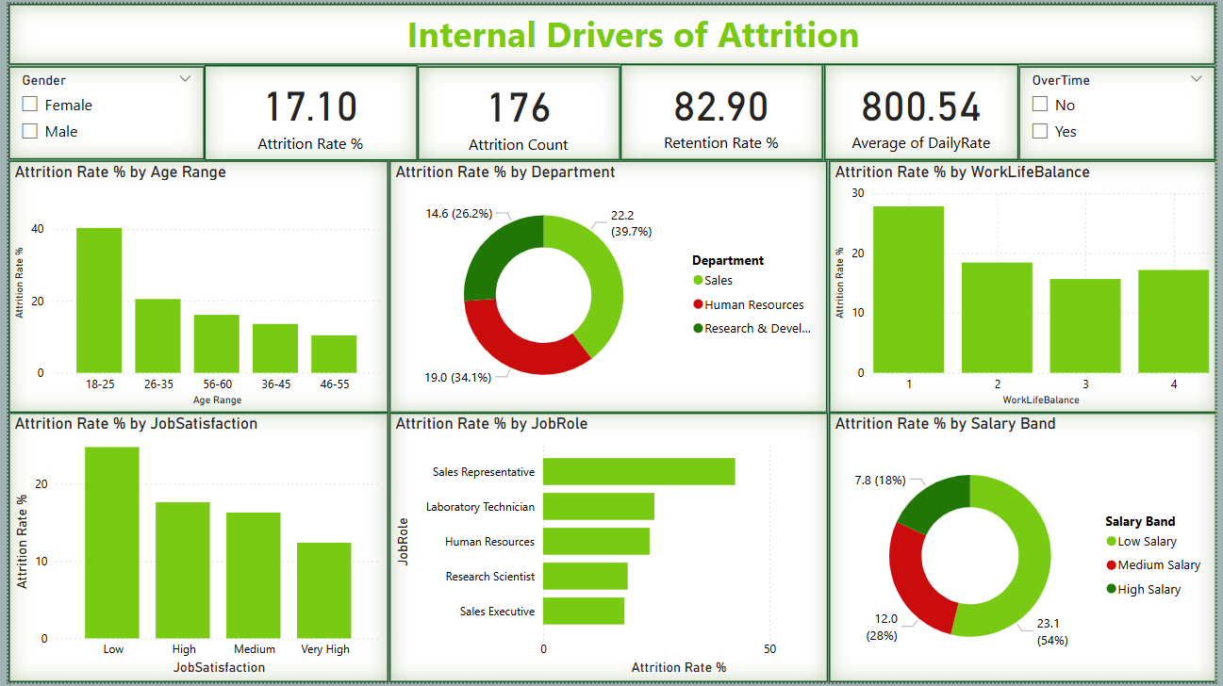
Dashboard Overview

Slide 6
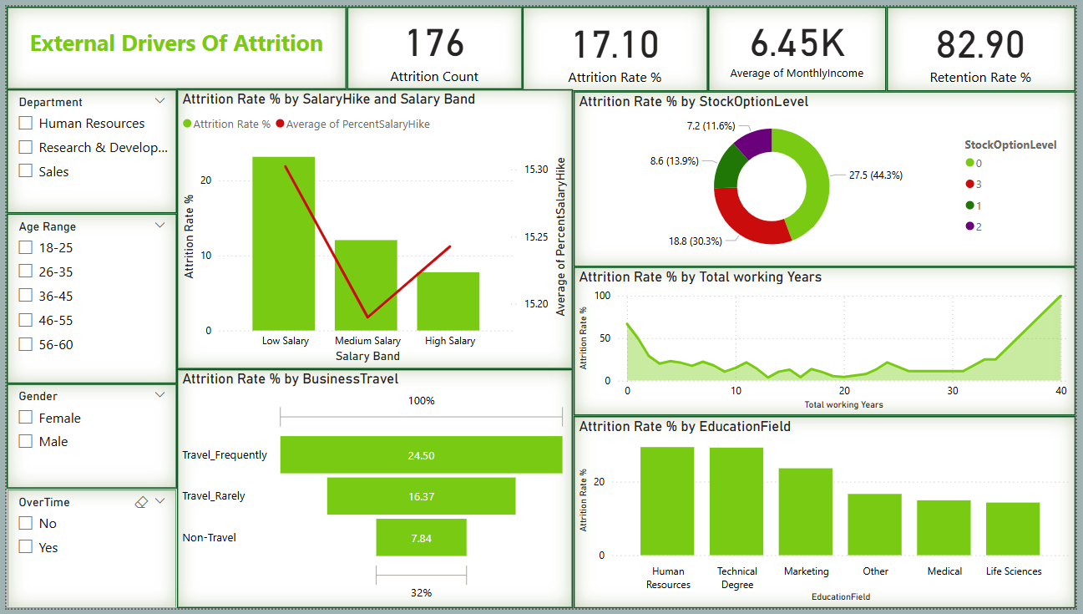
Dashboard Overview

Slide 7
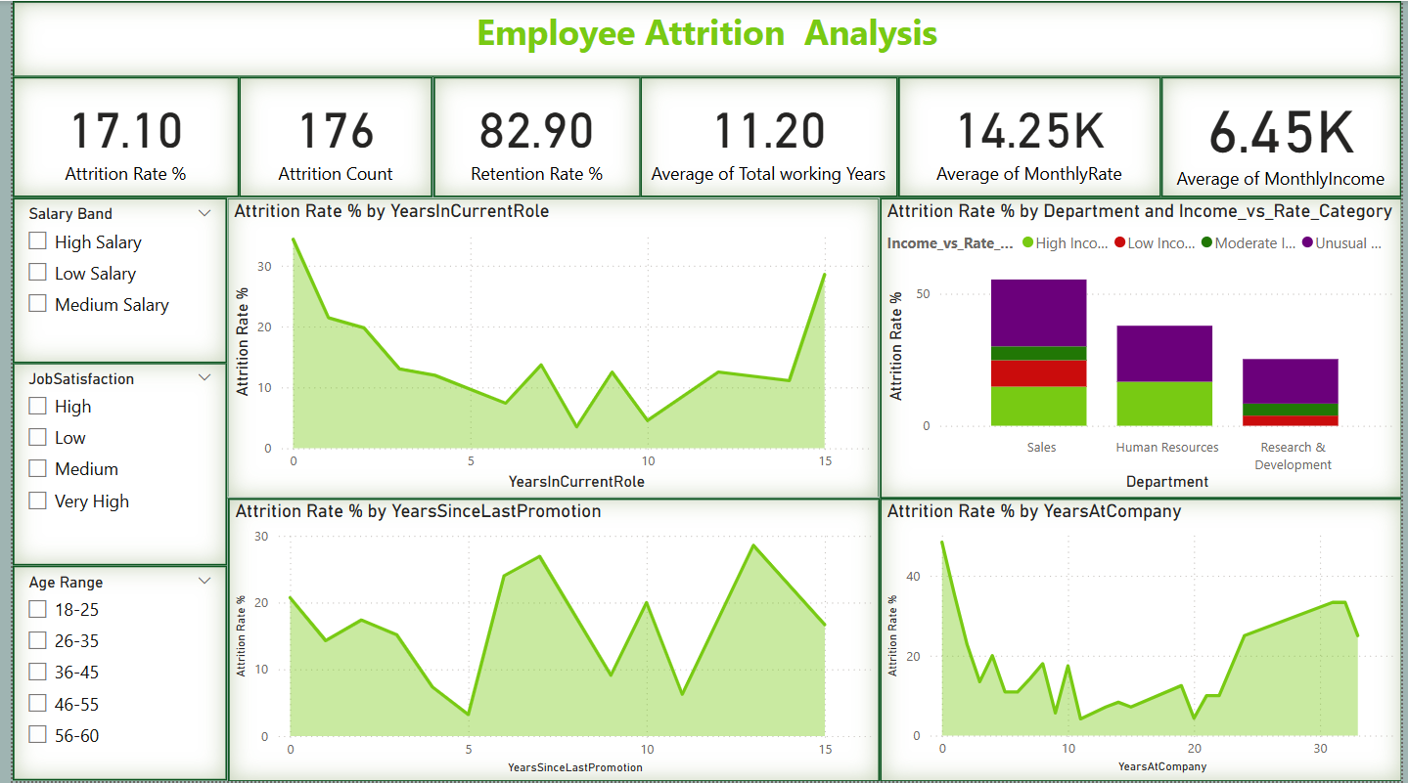
Dashboard Overview

Slide 8
Key Findings
Young employees leave more – High attrition in the 18-25 age group shows they seek better opportunities.
Sales & HR have high attrition – These departments struggle with job dissatisfaction and workload issues.
Low salaries increase attrition – Employees with low pay and no benefits are more likely to leave.
Work-life balance matters – Poor balance and frequent travel lead to higher attrition.
Job satisfaction drives retention – Happy employees stay longer, while those with low satisfaction leave faster.
Lack of promotions drives attrition - Indicating a need for better performance recognition and structured career growth paths.

Slide 9
Future Recommendations
Career Growth for Young Employees
Better Work-Life Balance
Higher Pay & Benefits
Improve Job Satisfaction
Reduce Travel & Provide Benefits
Enhance Career Growth & Promotion Cycles
Conclusion
Young employees and those in Sales & HR have higher attrition rates.
Low salaries and lack of benefits lead to more employees leaving.
Poor work-life balance and frequent travel increase attrition.
Low job satisfaction causes employees to leave faster.
Lack of promotions and growth opportunities also drive attrition.
Improving pay, satisfaction, and career growth can reduce attrition.

Slide 10

THANK YOU

